Slide 1
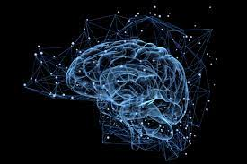

Hacking the brain: techniques to manipulate fish

Slide 2

Hacking the brain
Focus on genome engineering techniques
CRISPR/Cas9 in F0 animals
MIC-drop (automated screening of CRISPR constructs)
Enhancer trapping
Also – drugs, HPLC and fast-scan cyclic voltammetry

Slide 3
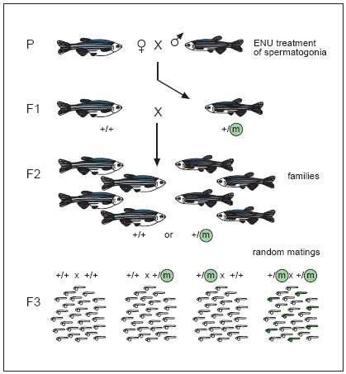
Mutants first created by chemical mutagenesis
Add ethylnitrosourea (ENU) to water
Screen for phenotype of interest
Difficult to identify genes once mutants
found – positional cloning
Large fish stocks needed

Slide 4
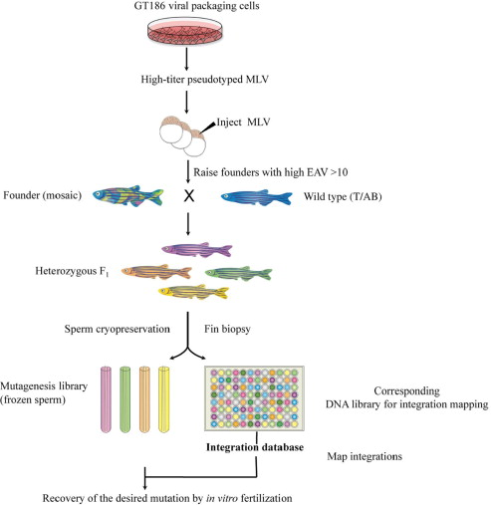
Insertional mutagenesis
Inject virus containing a mutagenic cassette
Tol2 transposon system
Inserts into genome (random location?) and
disrupts gene – “gene breaker”
Easier to identify mutations
Cassette can be tagged as well – GFP?

Slide 5
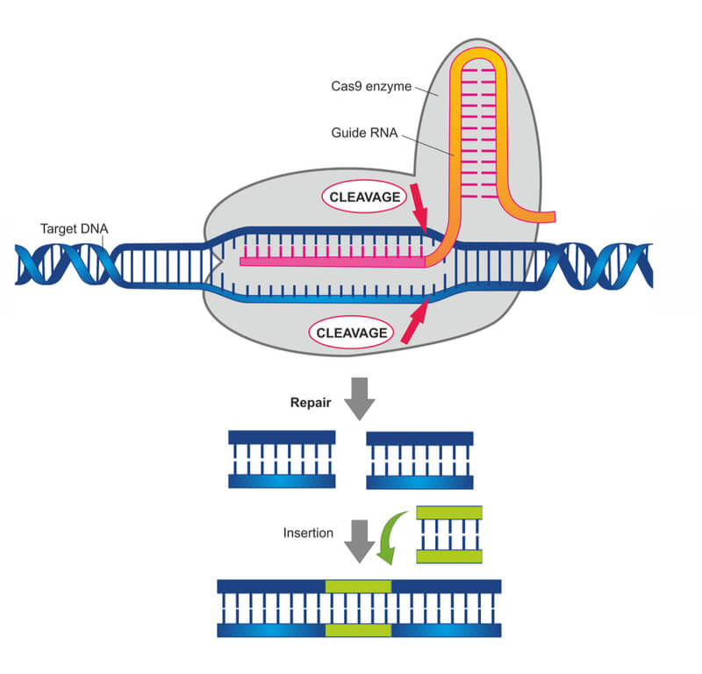
Genome engineering
Create mutations in chosen gene – does not identify novel genes related to a phenotype
Design a short guide RNA sequence. Co-inject
with Cas9 protein: Cas9 acts like molecular
scissors to cut the DNA sequence
The body’s natural repair mechanism –
“non-homologous end joining” repairs the cut
In some cases a mistake is made introducing a
mutation
Image from LabBiotech.eu

Slide 6
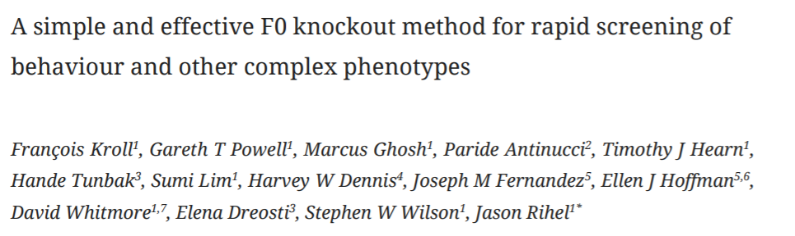
Increasing efficiency of CRISPR mutagenesis

Slide 7
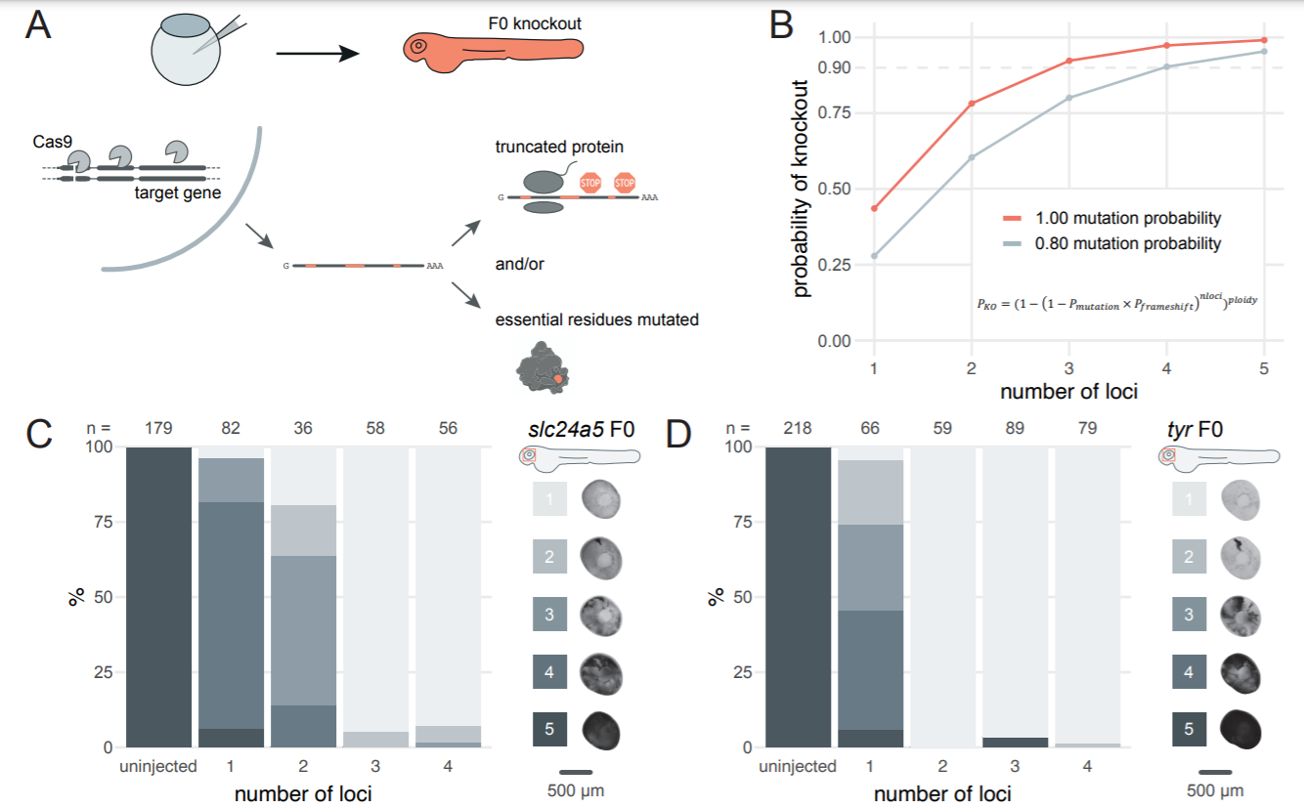
Creation of F0 CRISPR mutants
Combination of 3 guide RNAs targeting gene in 1:1 ratio with Cas9 protein
Kroll et al., BioRxiv

Slide 8
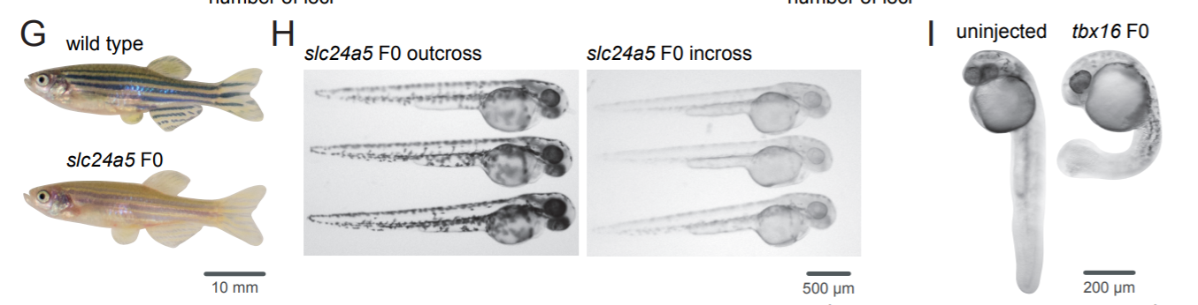
F0 phenotype persists into adulthood
F0 mutants are stable – can be grown to adulthood and incrossed to create a mutated
F1 generation
Kroll et al., BioRxiv

Slide 9
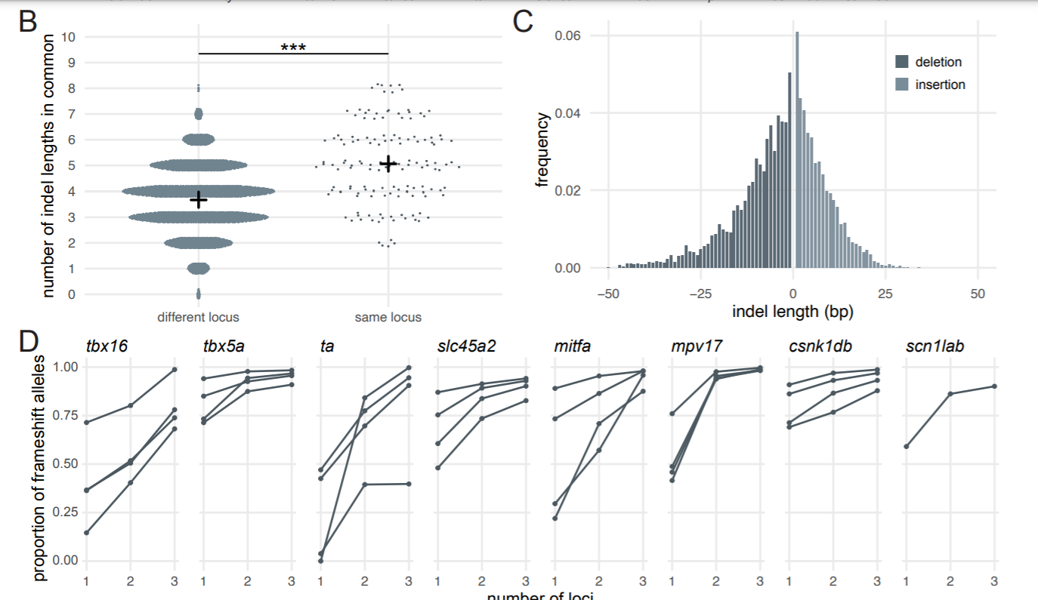
Short indels are most common
Kroll et al., BioRxiv

Slide 10
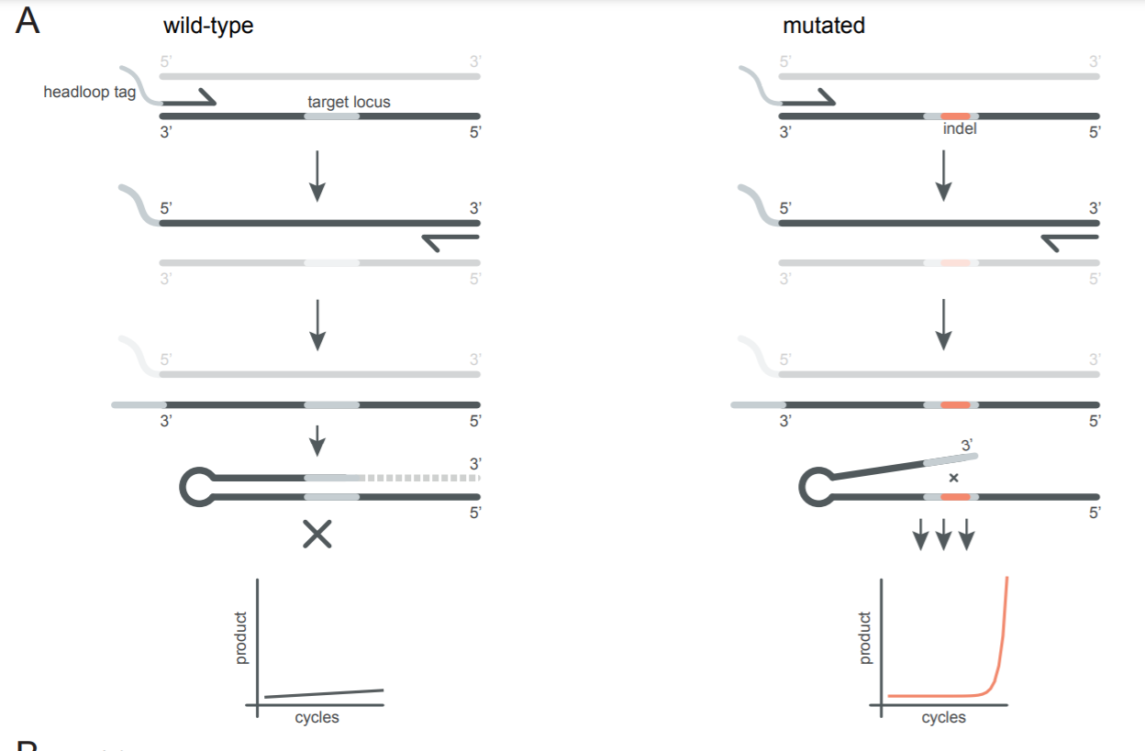
Headloop PCR
The addition of a tag to the 5’ primer inhibits amplification of the WT gene product
Mutation stops the headloop from forming
Kroll et al., BioRxiv

Slide 11
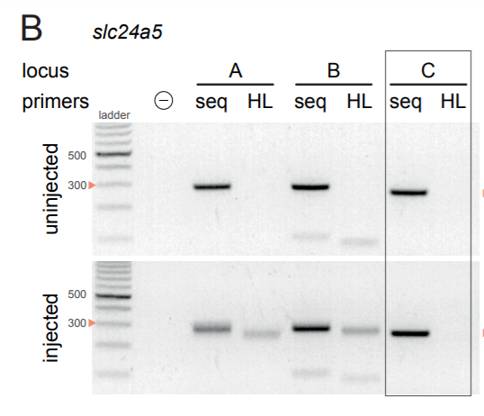
Headloop PCR
Seq = normal PCR primers
HL = headloop primers
Lane C shows an RNP that is
known not to be efficient
Kroll et al., BioRxiv

Slide 12
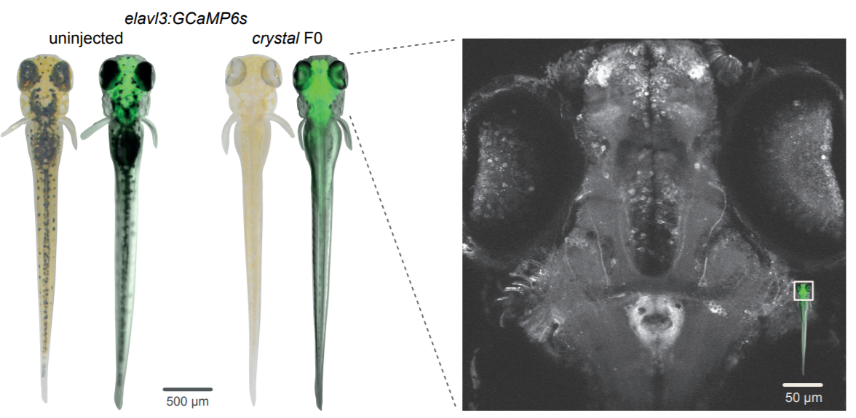
Multiple genes can be targeted in parallel
crystal lack the genes mitfa, mpv17 and slc45a2
Kroll et al., BioRxiv

Slide 13
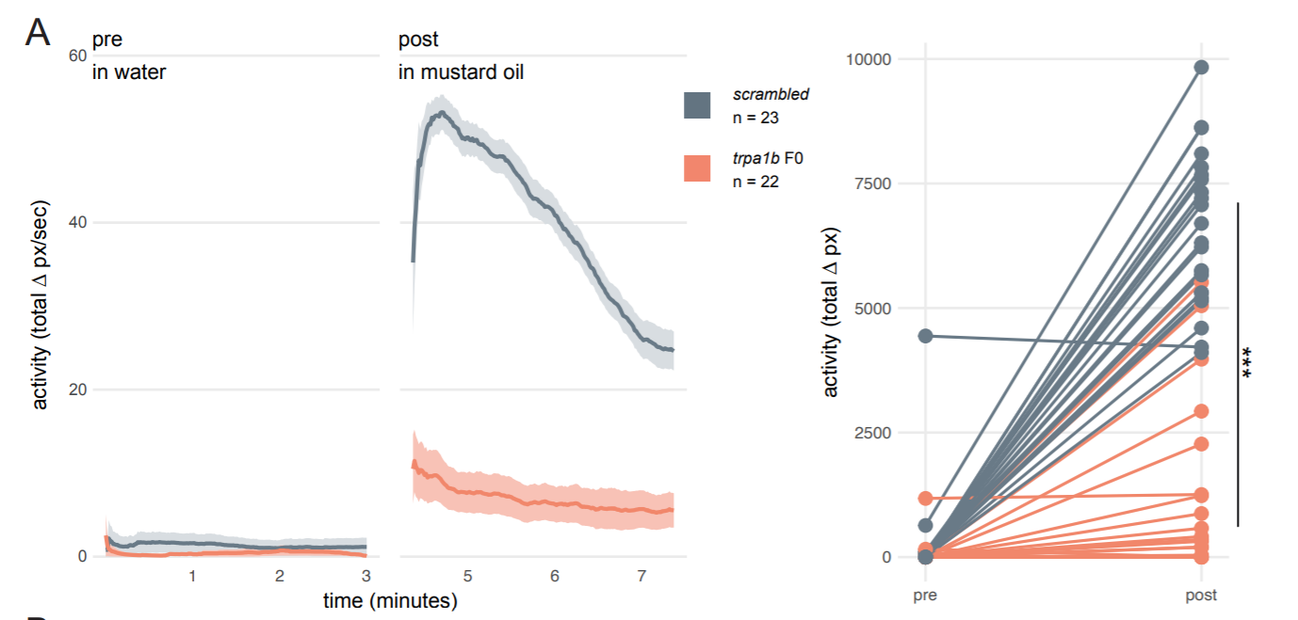
Complex behavioural phenotypes can be measured as well
Response of trpa1b mutants to mustard oil. trpa1b encodes an ion channel implicated in behavioural responses to chemical irritants
Kroll et al., BioRxiv

Slide 14
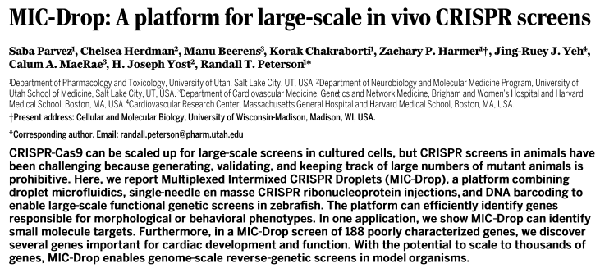
Can we speed up generation of mutant lines?
Microfluidics can be used to combine multiple CRISPR constructs in a small oil droplet
Automate injection into single cell zebrafish embryos

Slide 15
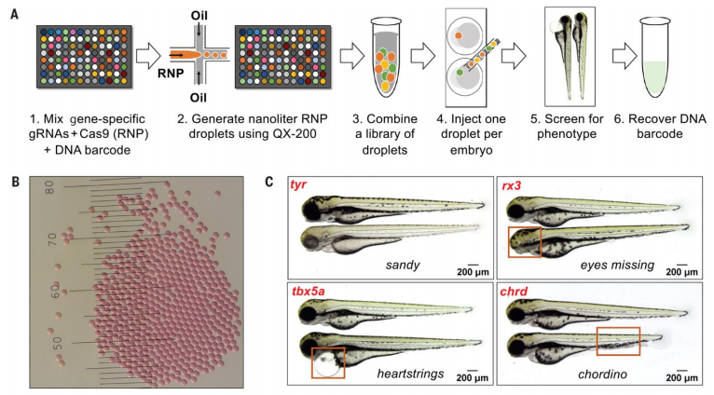
Multiplexing CRISPR constructs in oil droplets
Parvez et al., 2021

Slide 16
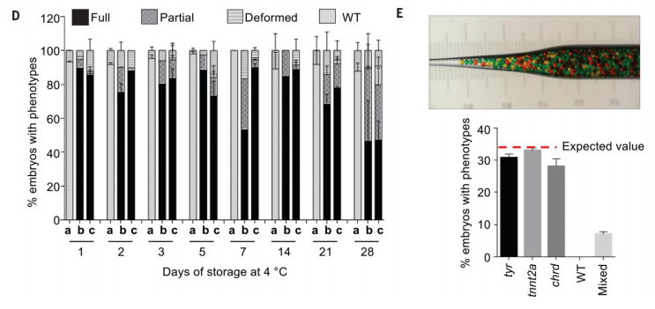
Constructs can be stored for one month
Parvez et al., 2021

Slide 17
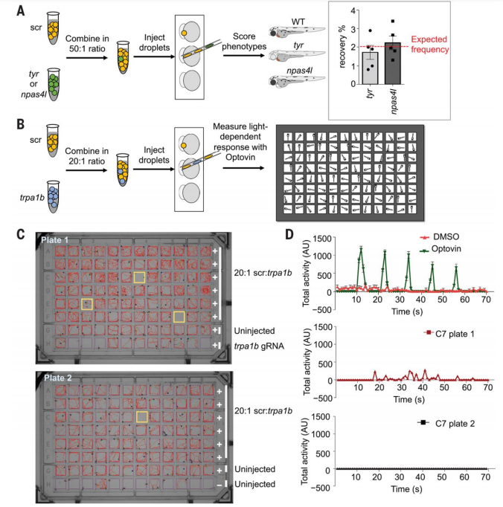
Phenotypes identified even when mixed with many other constructs
WT should move in response to optovin –
an irritant. trpa1b fish should not
Parvez et al., 2021

Slide 18
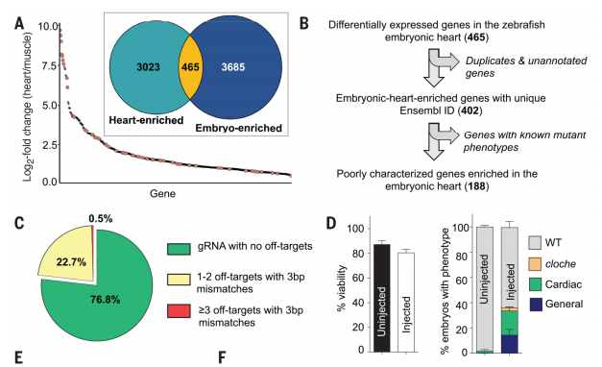
Searching for novel genes linked to a phenotype
Parvez et al., 2021

Slide 19
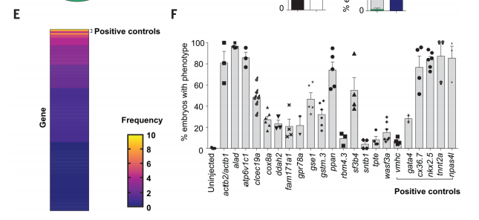
Searching for novel genes linked to a phenotype
Twelve new genes identified which lead to a heart phenotype when mutated
Parvez et al., 2021

Slide 20
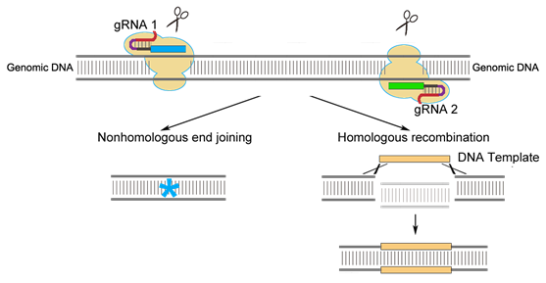
Genome engineering – knock in technology
DNA template with homology arms
Simultaneous inclusion of a novel DNA template can be used to introduce new
sequences: “Homologous Recombination”, “Knock-in”

Slide 21
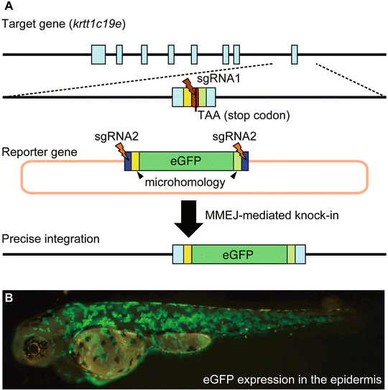
Genome engineering – knocking in genes
Example: knock-in of GPF to
krttc193 locus
Homology arms needed to insert
transgenic cassette
Image from Kawahara, 2017

Slide 22
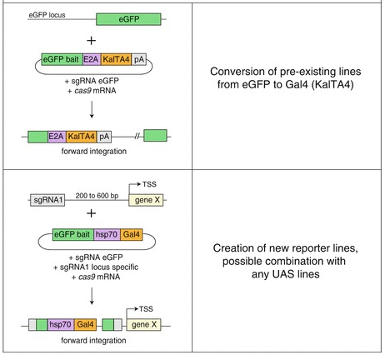
GFP lines can be converted to Gal4 lines
Albadri et al., 2017

Slide 23
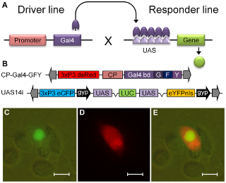
Gal4:UAS system
Uses pairs of transgenic lines to create a toolkit for gene manipulation:
Gal4 driver lines binds to- and activates
UAS reporter
Acts an amplification system – stronger
signal possible

Slide 24
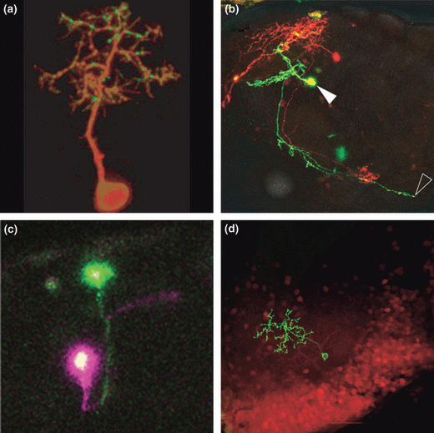
BGUG: stochastic labelling of single neurons
Inject several plasmids at same time:
(i) brn3a-hsp70:loxP:DsRed:loxP:Gal4-VP16
(ii) pCS2:cre
(iii) UAS:GFP
Heatshock animals
Random recombination leads to sparse
expression in few cells
Can test contribution of few neurons to circuit
activity
Scott, 2009

Slide 25
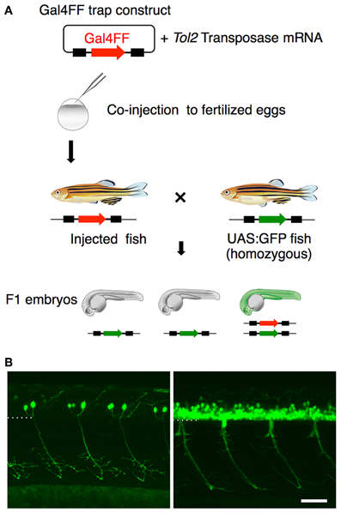
Enhancer trapping
Cassette contains reporter with no promoter, or
weak promoter activity
Insertion in genomic position next to an enhancer
Will drive expression of the reporter cassette
In this case Gal4, to into a UAS:GFP line
Cassette could include anything (e.g. ChannelR)
Asakawa et al., 2013

Slide 26
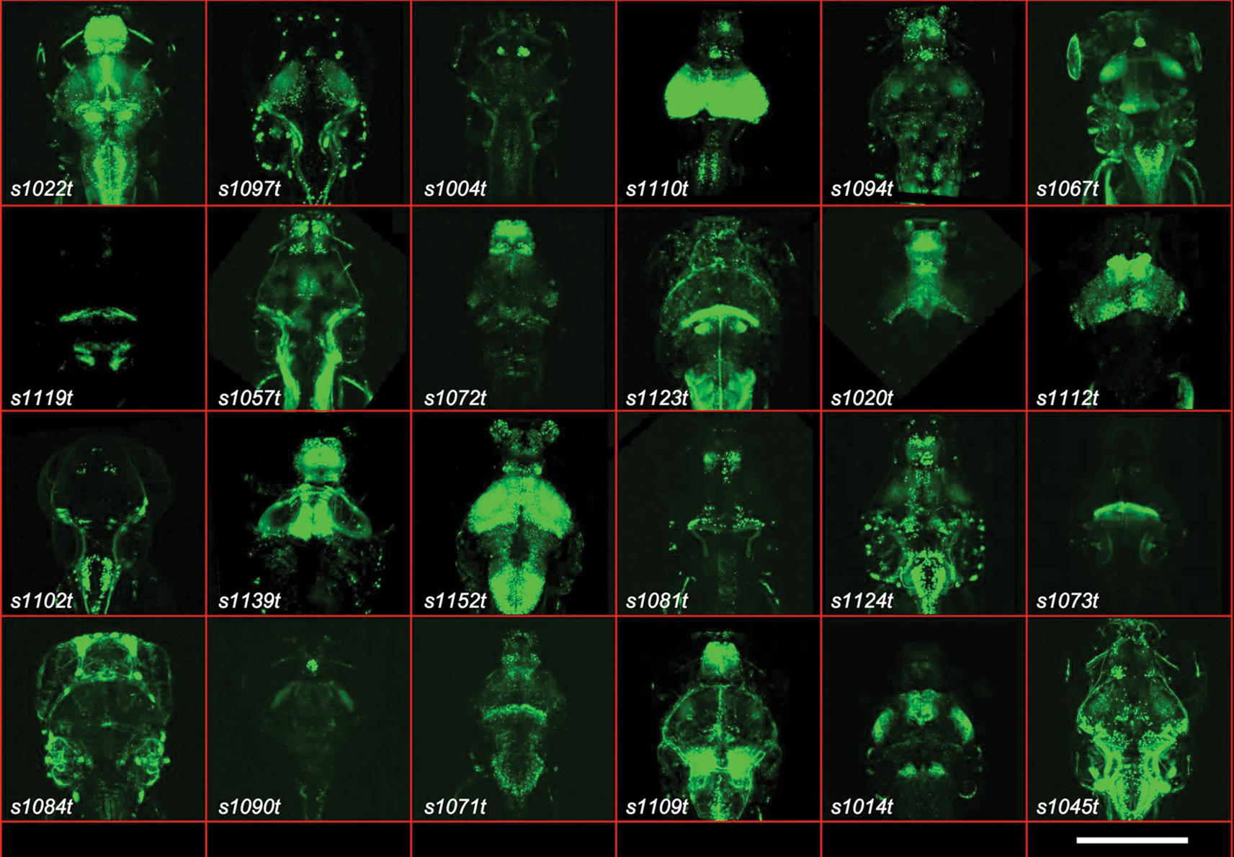
Example: create library of lines in different tissues

Slide 27
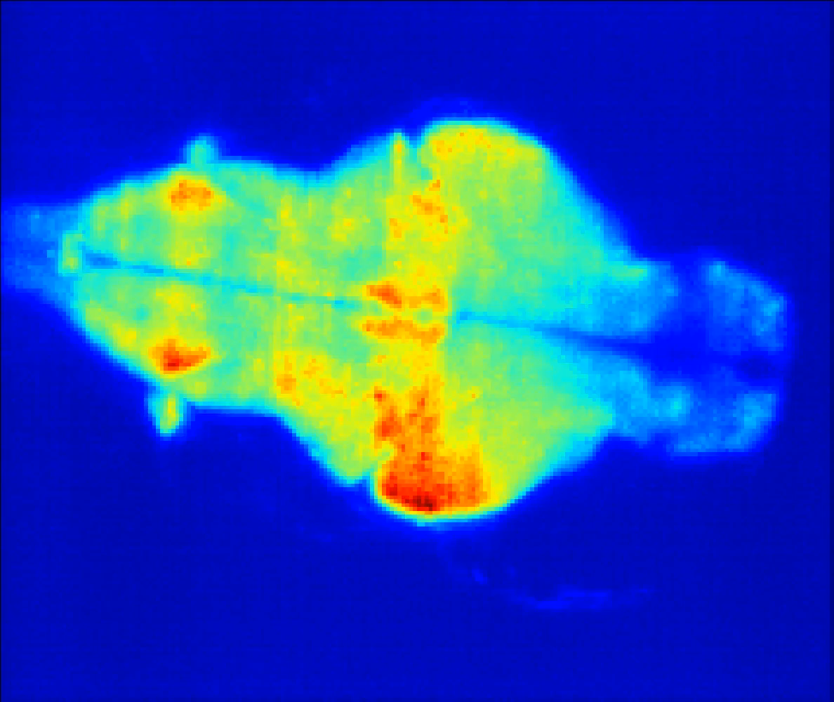
Drugs can also be useful tools
A well characterised drug can alter brain activity acutely
Need to check target selectivity in fish – pharmacology?
Easy to control timing of application
Read-outs of drug activity?
Response of zebrafish brain to caffeine

Slide 28
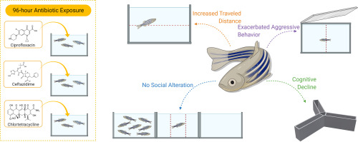
Linking drugs to behaviour
Where are the drug targets expressed?
Which neurotransmitters are modified

Slide 29
HPLC measurements of neurotransmitter levels
HPLC = High Pressure Liquid Chromatography

Slide 30
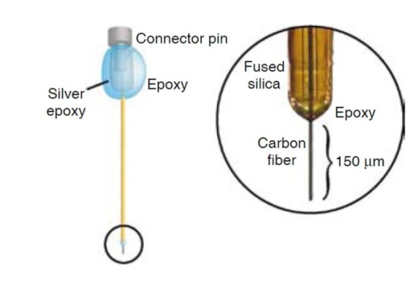
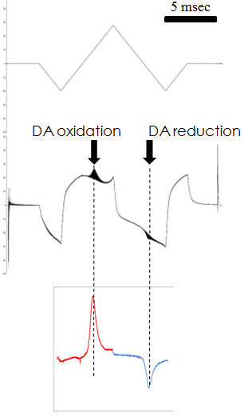
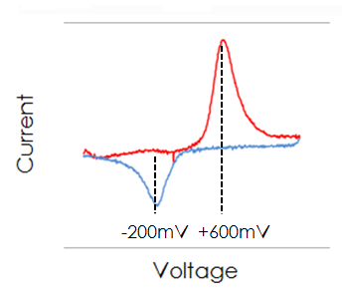
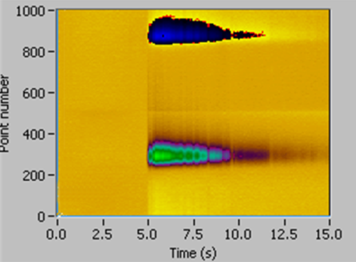
Fast-scan cyclic voltammetry – neurotransmitter release and reuptake
Measure oxidation and reduction of analytes at the
surface of a carbon fibre electrode
+1.4V
-0.3V
Waveform
Oxidation and Reduction
Voltage vs. Current
Subtract background signal
Colour Plot
Notes:
Apply a potential which induces oxidation of compounds through redox reaction and produces a current at working electrode
Subtract background signal and amplify output to produce voltammogram and identify compounds
Calibrate electrode to establish concentration of neurotransmitter present

Slide 31
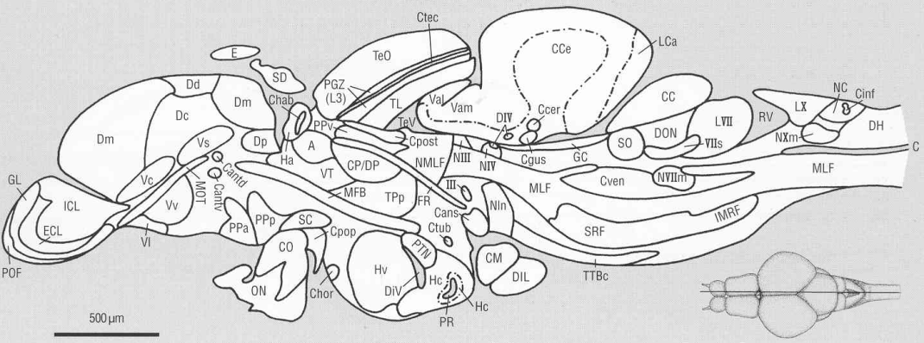
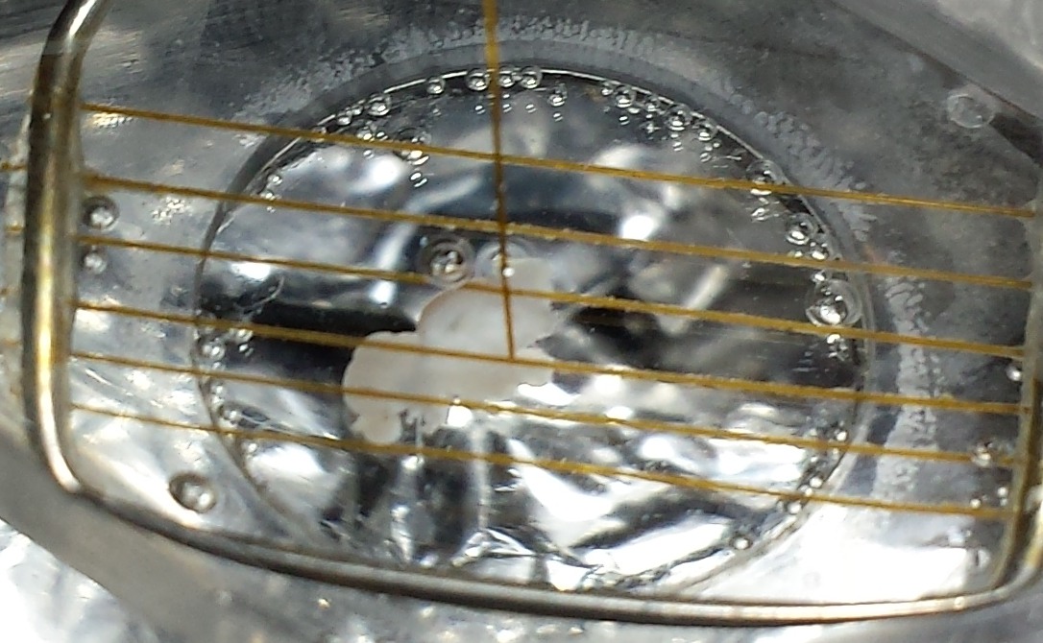
Regions of interest of voltammetry
Sagittal section through adult brain
Dopamine neurons found in the posterior tuberculum (diencephalon)
5-HT neurons found in the raphe nucleus
Histamine found in hypothalamus
Vasotocin neurons found in preoptic area of hypothalamus
Cartoon modified from Wullimann adult atlas

Slide 32
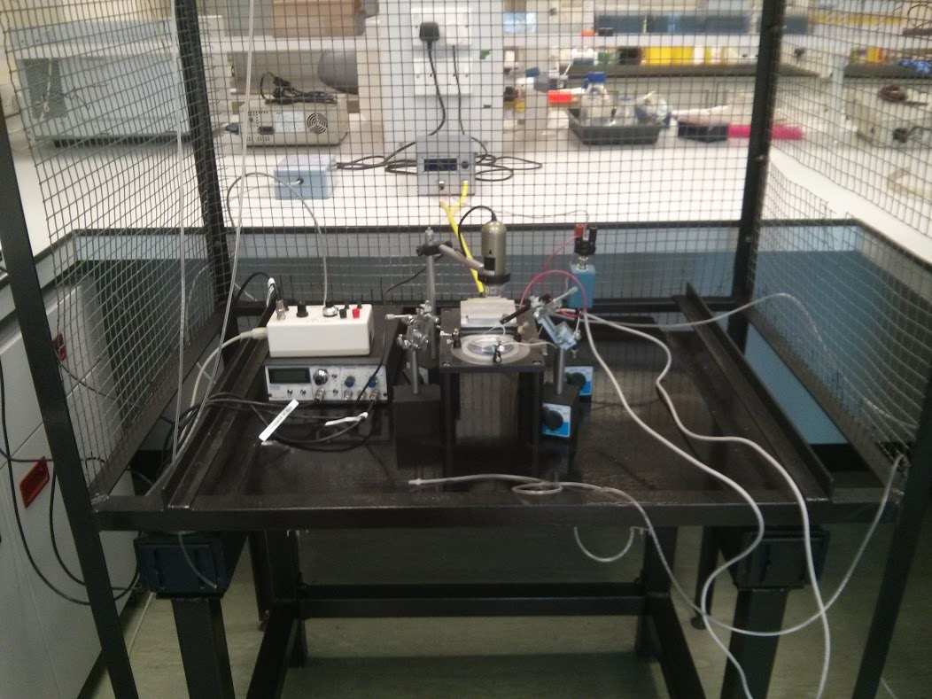
FSCV setup

Slide 33
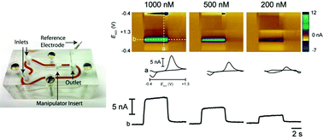
Representative neurotransmitter traces

Slide 34
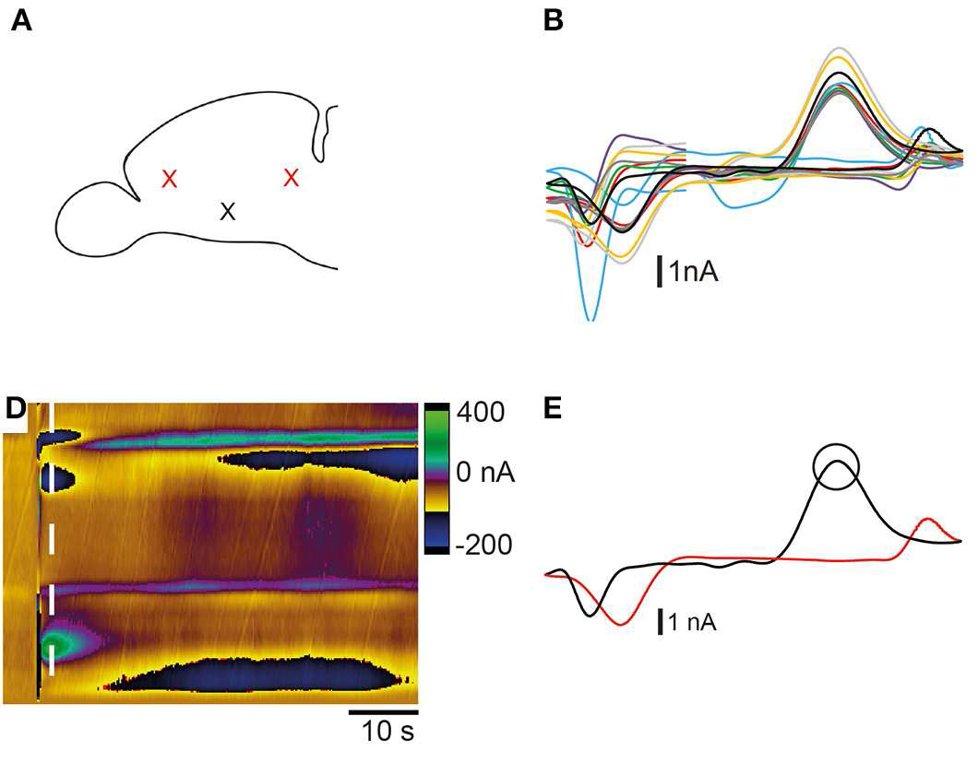
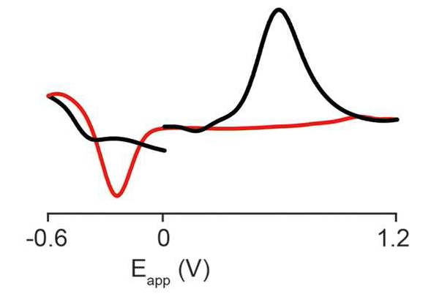
Electrical stimulation of the zebrafish telencephalon
Colour plot
Recording from telencephalon
Representative DA trace
Concentration of DA calculated by looking at area under curve
Identity of DA confirmed by pharmacological manipulation (agonists / antagonists)
Notes:
This is low intensity stimulation

Slide 35
Summary
Many techniques to manipulate zebrafish brain and measure behaviour
Genetic techniques – CRISPR/Cas9, MIC-drop, knock-in
Transgenic approaches – mutagenesis and enhancer trapping
Well-characterised drugs can be used as well
HPLC and fast-scan cyclic voltammetry to measure changes in neurotransmitter signalling

